Slide 1
Assalamualaikum🫡 hello EvryOne Welcome to our presentation
​

Slide 2




MEET OUR Extended TEAM
Jalis mahamud
Roknuzzaman
Faysal ahmmed
Hasibul ismal
32
35
37
41
csE
csE
CSE
CSE
Borisal
Rangpor
Cumilla
Borisal

Slide 3
.
False Position Method:
False Position method is also called Regula Falsi method a numerical method in Mathematics to find a root of agiven function.
Function:
Root of a function f(x) = a value x2 such that: f(x2) = 0.

Slide 4
Algorithm of False Position Method
Algorithm of False Position method is given below:
Step-1: Find points x0 and x1 such that x0<x1 and
f(x0). ⋅f(x1)<0.
Step-2: Take the interval [x0, x1] and find next
value x2=x0 - f(x0). ((x1−x0)f x1 −f x0)
Step-3: If f(x2) = 0 then x2 is an exact root,
else if f(x0)⋅f(x2)<0 then x1=x2,
else if f(x1)⋅f(x2)<0 then x0=x2
Step-4: Repeat steps 2 & 3 until f(x2)=0 or |f(x2)|≤Accuracy

Slide 5
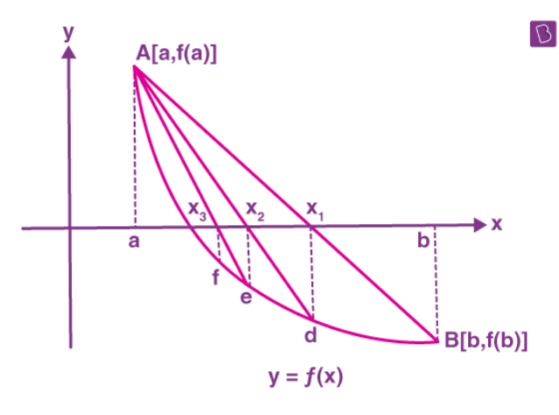
Geometrical representation of the roots of the equation f(x) = 0 can be shown as:
False position method graph:

Slide 6
THANK YOU
faysalahmmedcse@gmail.com​
jalis@contoso.com
www.rukonzara.com

